Slide 1



House price prediction project
By : Abhay Surma

Slide 2
Business Problem Framing
Housing and Real estate Markets are one of the major contributor’s in a country’s economy . It is very large market and various companies are working in this domain. Data Science can play a vital role in solving problems related to this domain and can help the countries in their overall revenue , profits and improving their marketing strategies . Machine learning techniques can be used for achieving business goals for this housing companies . Our Problem is related to one of such U.S based housing company named Surprise Housing which want to enter Australian Market . The company want to use Data Analytics to purchase houses at a price below their actual values and flip them at a higher prices. The company has collected a dataset from the sale of houses in Australia . The company is looking at prospective properties to buy houses to enter the market . we will build a model using Machine Learning to predict the actual value of the prospective properties and it will help the company to decide whether to invest in property or not.

Slide 3
Conceptual Background of the Domain Problem
Trends in housing prices indicate the current economic situation and also are a concern to the buyers and sellers. There are many factors that have an impact on house prices, such as the number of bedrooms and bathrooms. House price depends upon its location as well. A house with great accessibility to highways, schools, malls, employment opportunities, would have a greater price as compared to a house with no such accessibility. Predicting house prices manually is a difficult task and generally not very accurate, hence there are many systems developed for house price prediction.

Slide 4
Undertaken
Growing unaffordability of housing has become one of the major challenge for countries around the world. In order to gain a better understanding of the commercialized housing market we are currently facing , we want to figure out what are the top influential factors of the housing price. Apart from the more obvious driving forces such as the inflation and the scarcity of land, there are also a number of variable that are worth looking into. Therefore , we choose to study thr house price prediction., which enables us to dig into the variables in depth and to provide a model that could more accurately estimate house prices. In this way, people could make better decision when it comes to home investment.
Our objective is to discuss the major factors that effect housing price and make precise prediction for it. We use 80 explanatory variables including almost every aspect of residential homes in Australia. Methods of both statistical , regression models and machine learning models are applied and firther compared according to their performance to better estimate the final price of each house. The model provides price prediction based on similar comparable of people’s dream house, which allow both buyers and sellers to better negotiate home prices according to market treand.

Slide 5

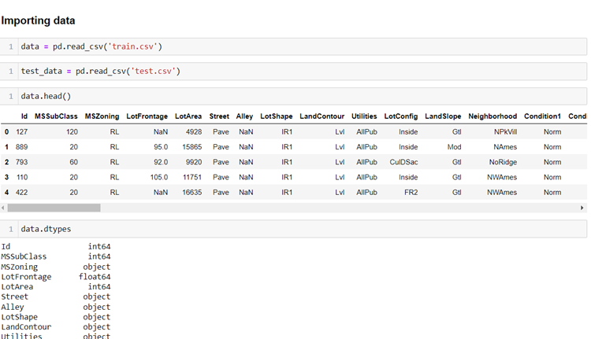
Loading Necessary libraries and Train and test dataset
Now we will check the columns and shape of the dataset Simultaneously with the same process we will check our test data set,
1168 rows and 81 columns - train data set
and 292 rows and 80 columns - test data set.

Slide 6

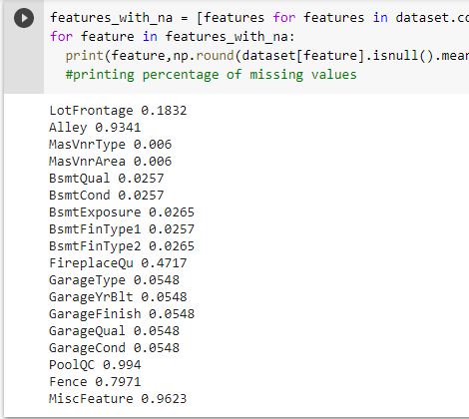
Let’s check null in dataset
i) Nan value can't be imported for columns -
Alley, FireplaceQu, PoolQC, Fence, MiscFeature
ii) other columns which are having less nan value and we can import values for that column by using any imputer technique -
LotFrontage
MasVnrType
MasVnrArea
BsmtQual
BsmtFinType1
BsmtFinType2
GarageType
GarageYrBlt
GarageFinish
GarageQual
GarageCond

Slide 7
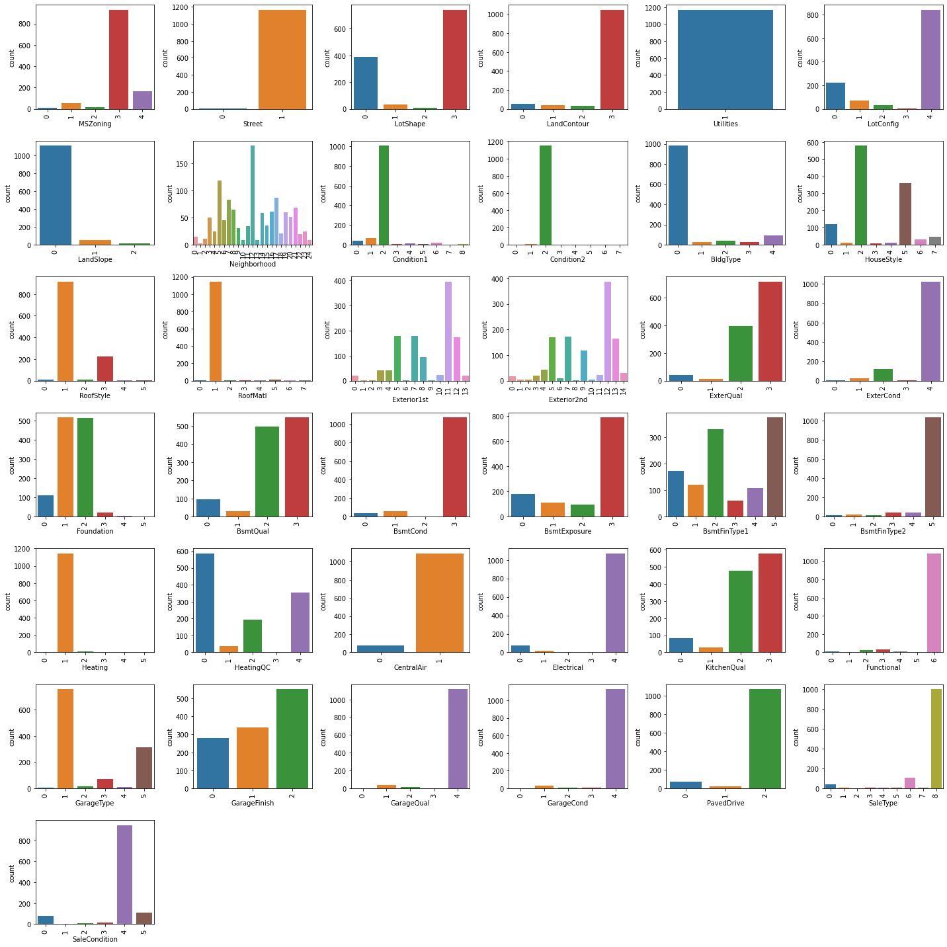
Visualization
Univariate Analysis:

Slide 8

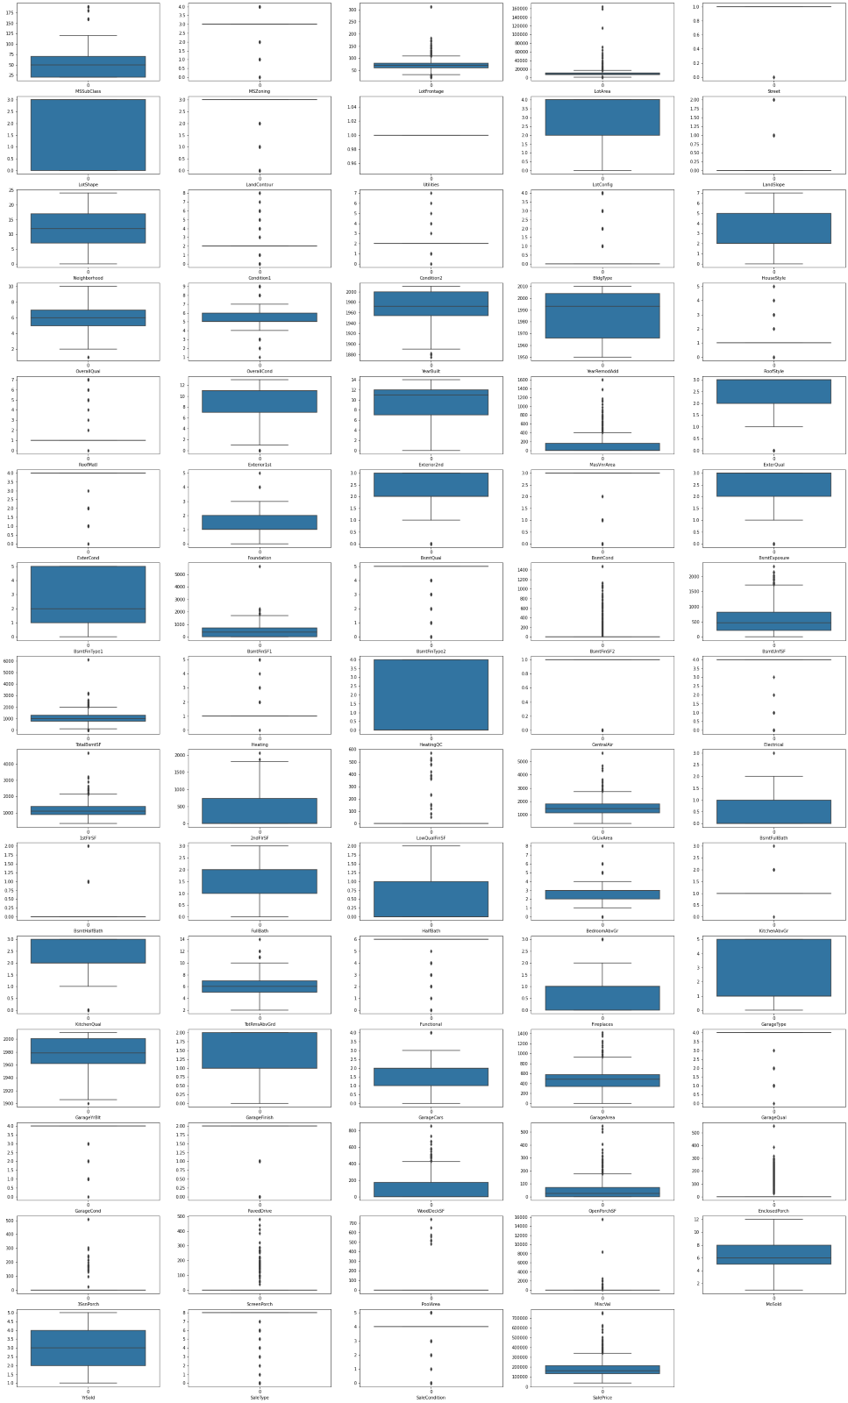

.
OUTLIERS -
We can't remove the outliers we don’t have the good amount of data as outliers are 13% of data we will not drop it.

Slide 9
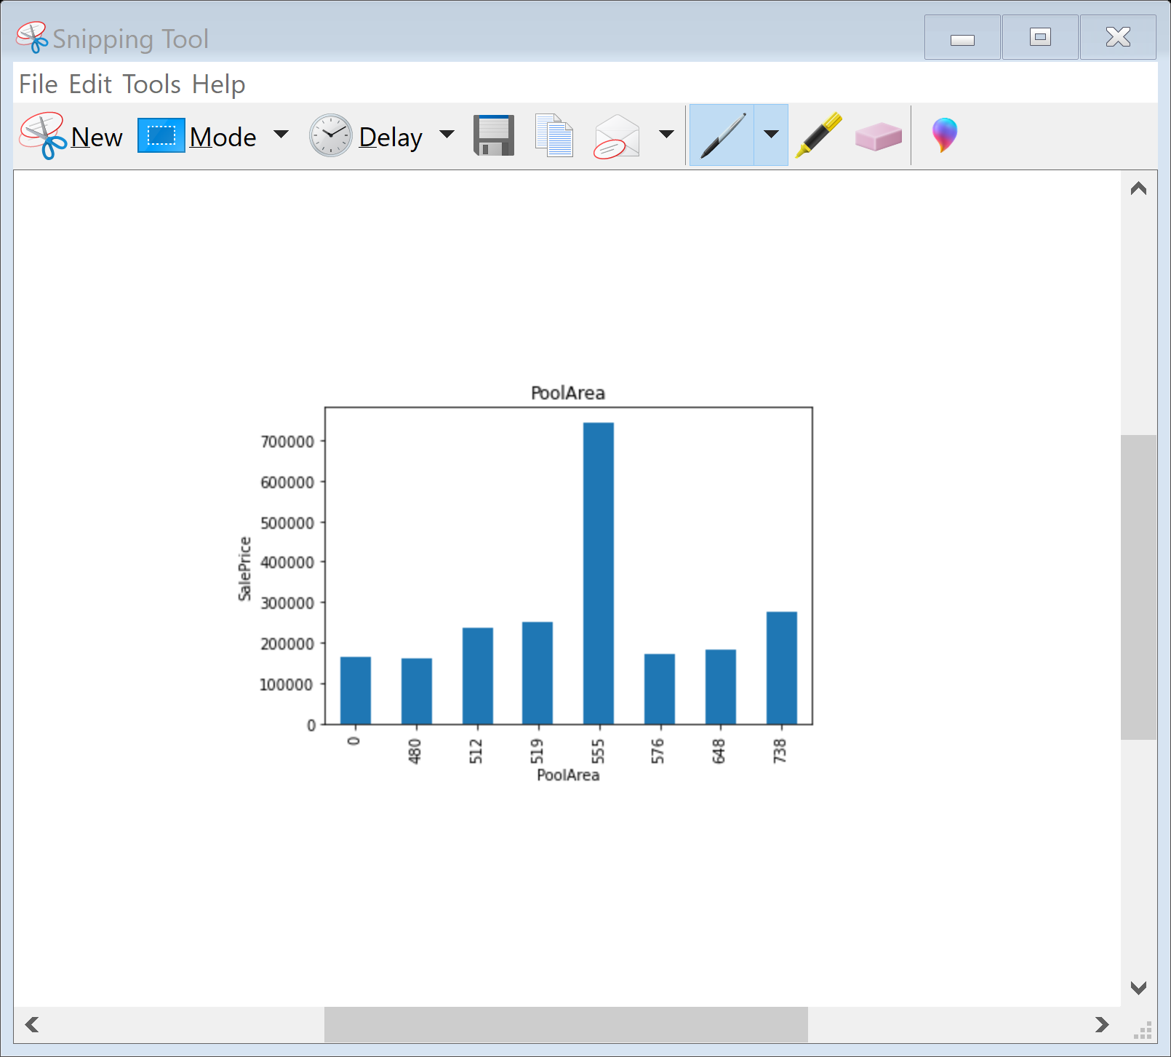
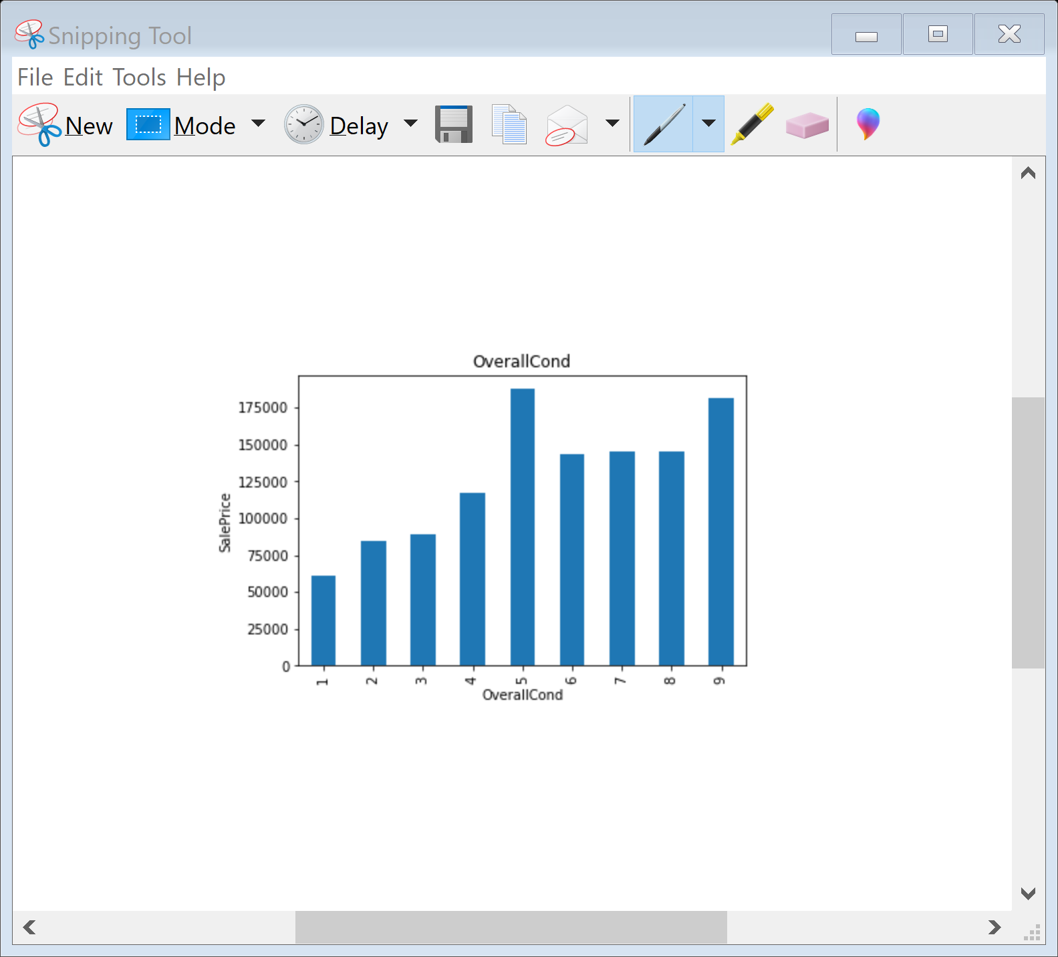
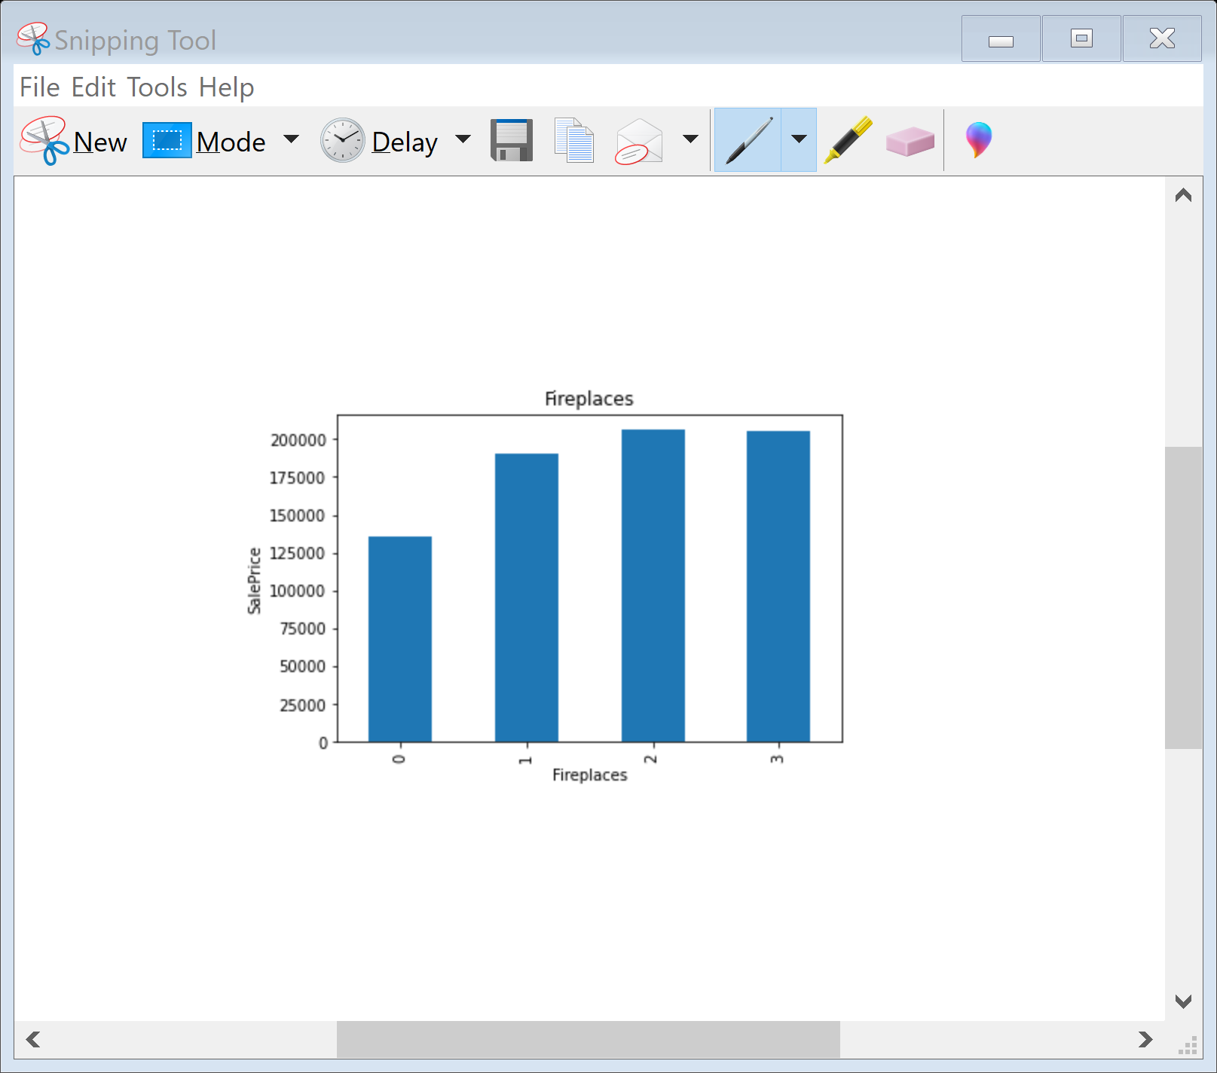
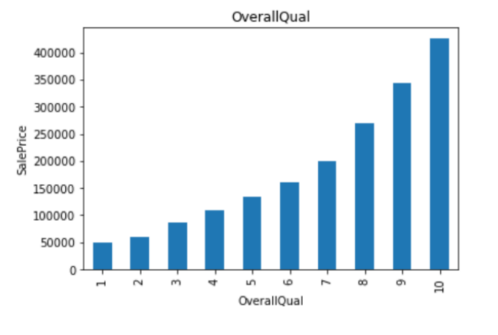
As we can see the overall quality is increasing the price is high. If the overall condition of the house is average the price is more that others. As there is increase in no of fire places the price of house is rising. As the house has a pool area of 555 sq feet the price of the house is more as compared to others.

Slide 10
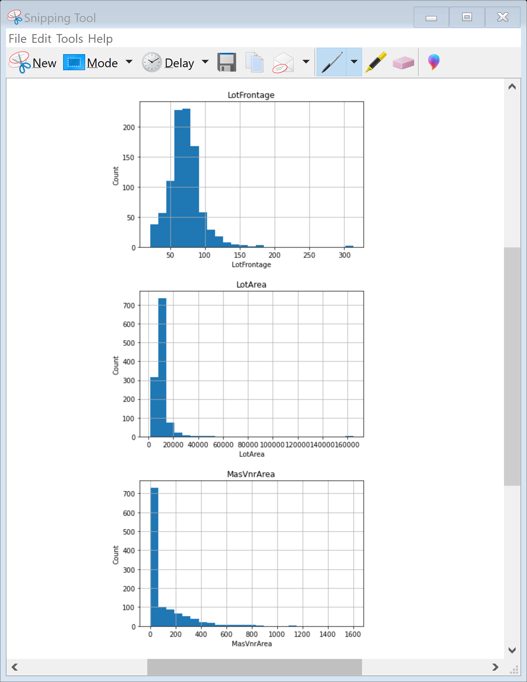
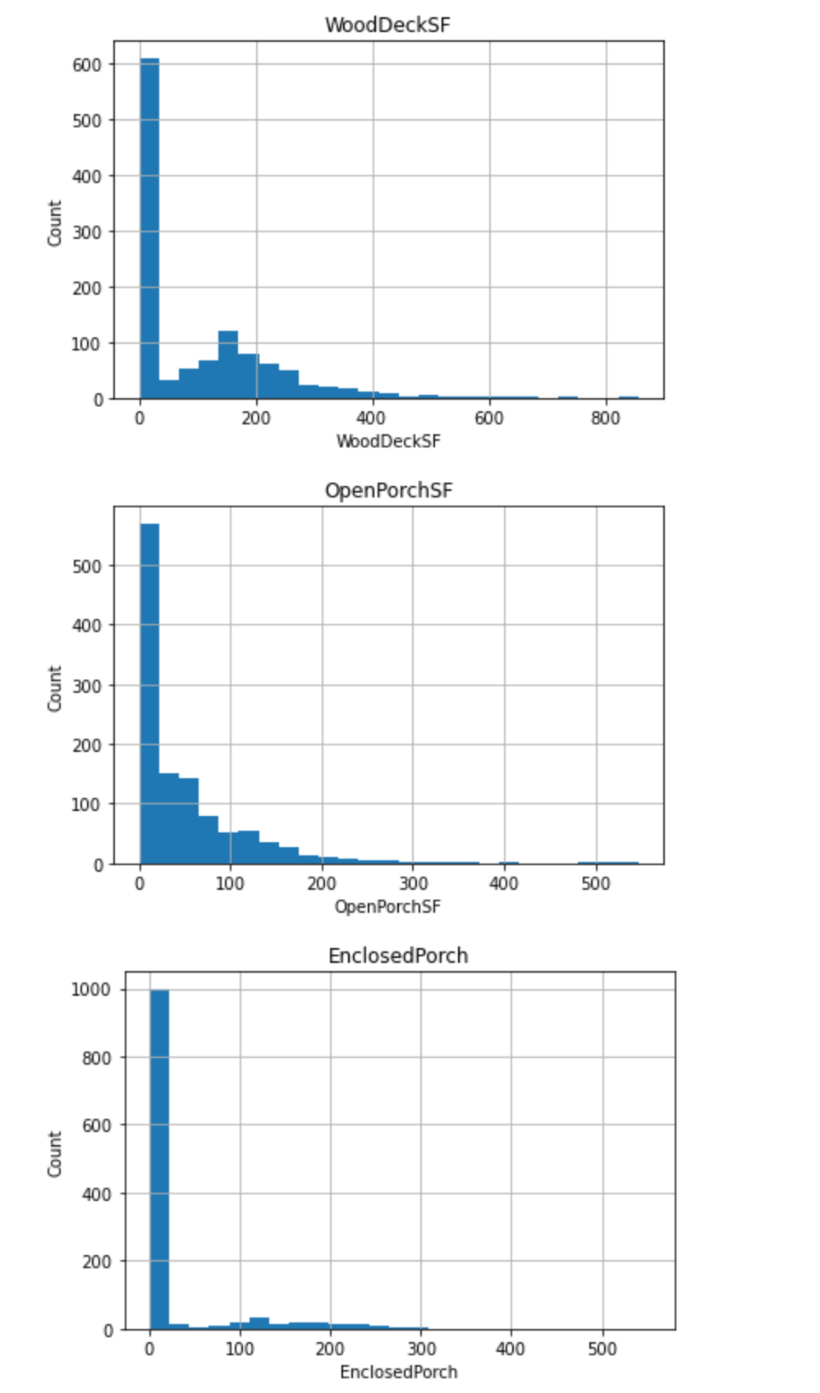
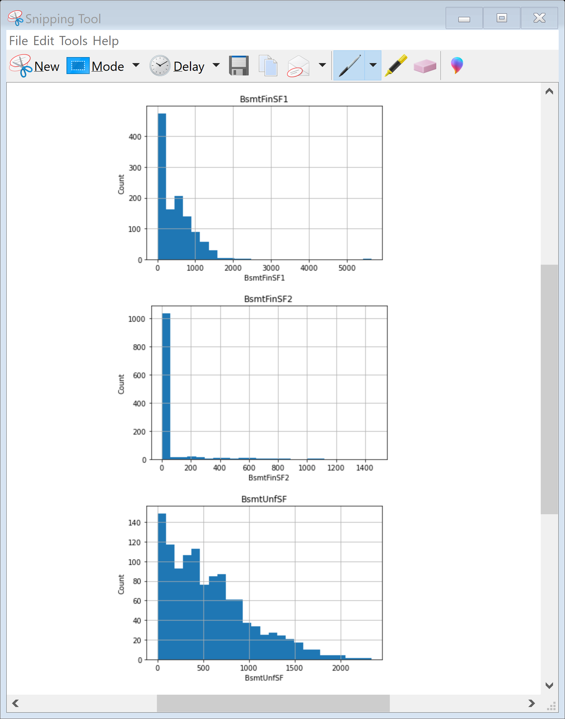
Here you can see that the data is skewed so we will perform power transformation to reduced skewness of the data.

Slide 11
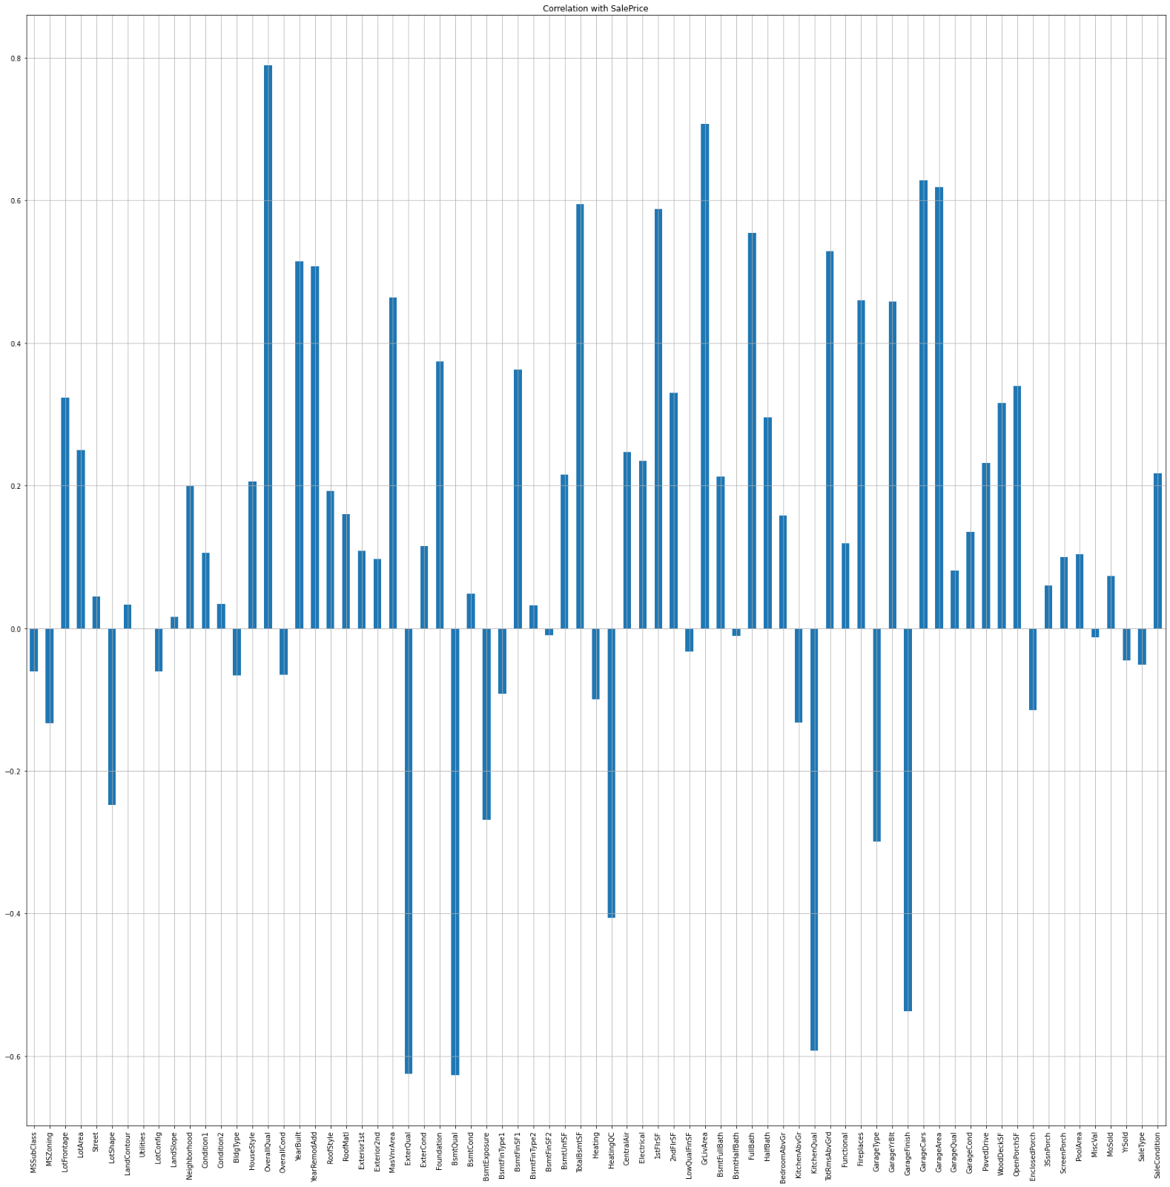
Statistical Analysis
In this we found that Variables like OverallQual (overall material and finish of the house ) , Year Built , TotRmsAbvGrd ( Total rooms above grade (does not include bathrooms) , GarageCars (Size of garage in car capacity ) ,GarageArea ( Size of garage in square feet ) , GrLivArea ( Above grade (ground) living area square feet ) , FullBath ( Full bathrooms above grade ) have positive relationship with the sales Price.
YearBuilt, YearRemodAdd, GarageYrBuilt are negatively related with sale price

Slide 12
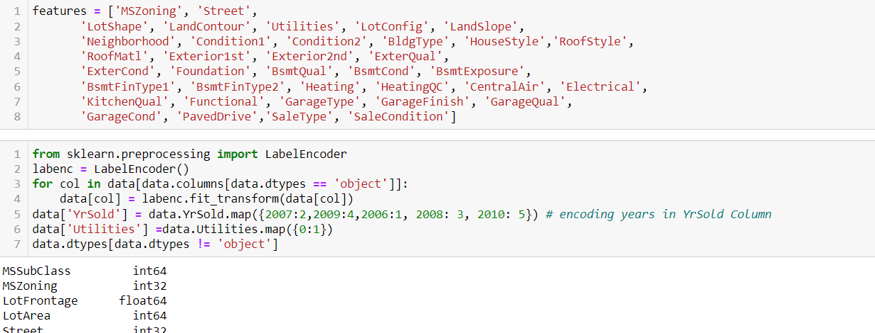
Data preprocessing of train data and test data
First of all we will drop columns Alley , MiscFeature , PoolQC , Fence and GarageYrBlt because more than 80 % data in these columns are missing if we replace these missing data with some data it can give us wrong prediction in the final model thus making our model less effective so better to drop these columns.
The data of the categorical columns needs to be encoded using LabelEncoder

Slide 13
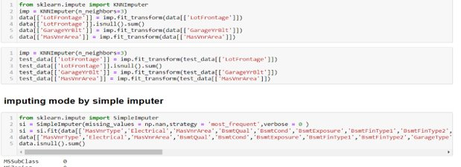
Data preprocessing of train data and test data
KNN imputer for continous data
Simple imputer for categorical data

Slide 14
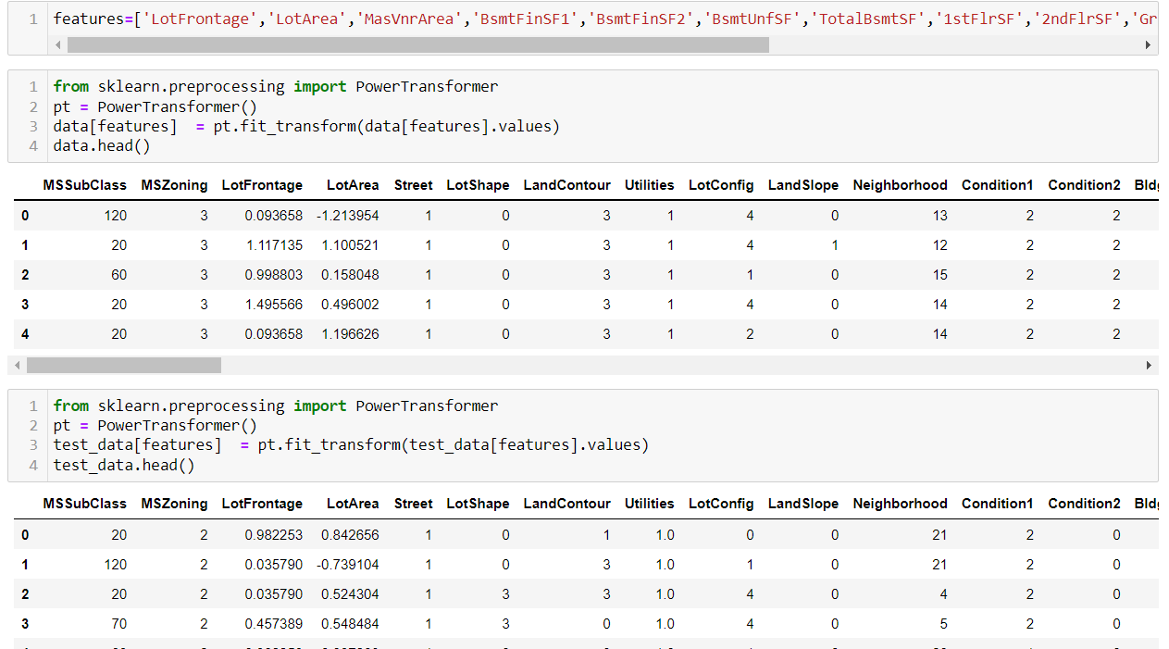
Data Scaling - Using power transformer method –" yeo johnson"

Slide 15
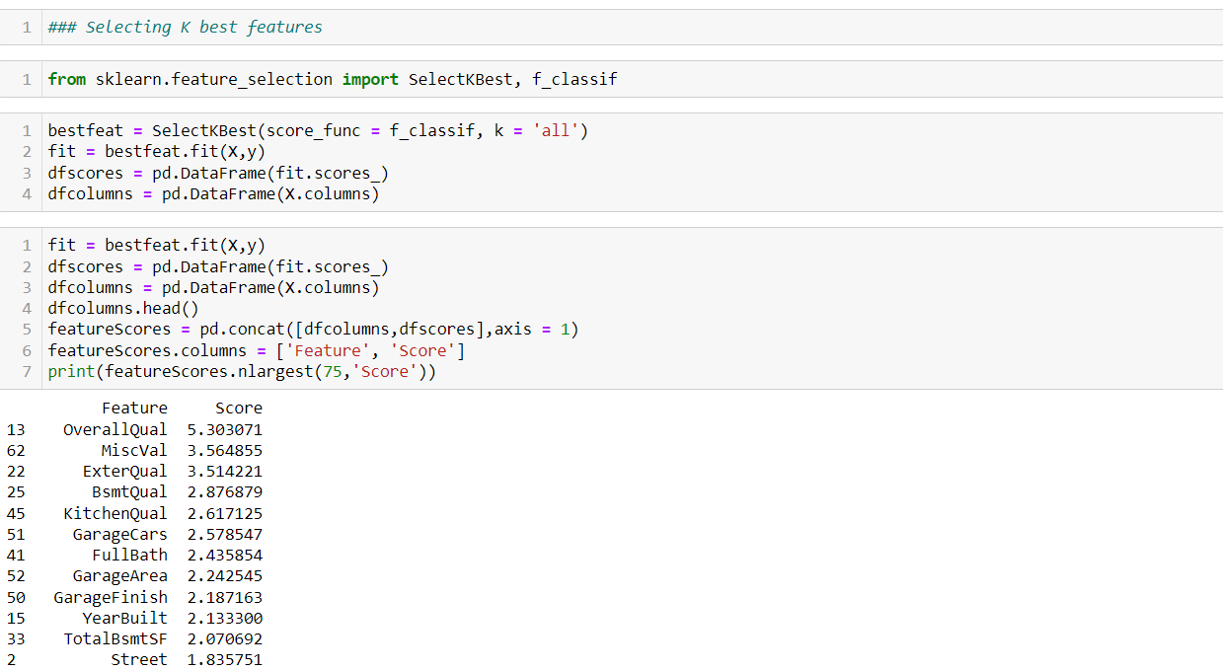
Selecting K – best features -

Slide 16
Model/s Development and Evaluation
As we know that it is a Regression problem in which our output is ‘Sale Price’ so we will use the regression model like linear Regression , , Gradient Boosting Regressor , Random Forest Regressor , Xgboost we will train our training data using these algorithms and then we will test on the finalised test data set for final house price prediction . The algorithm which is giving better accuracy and Cross value score will be chosen as final model.

Slide 17
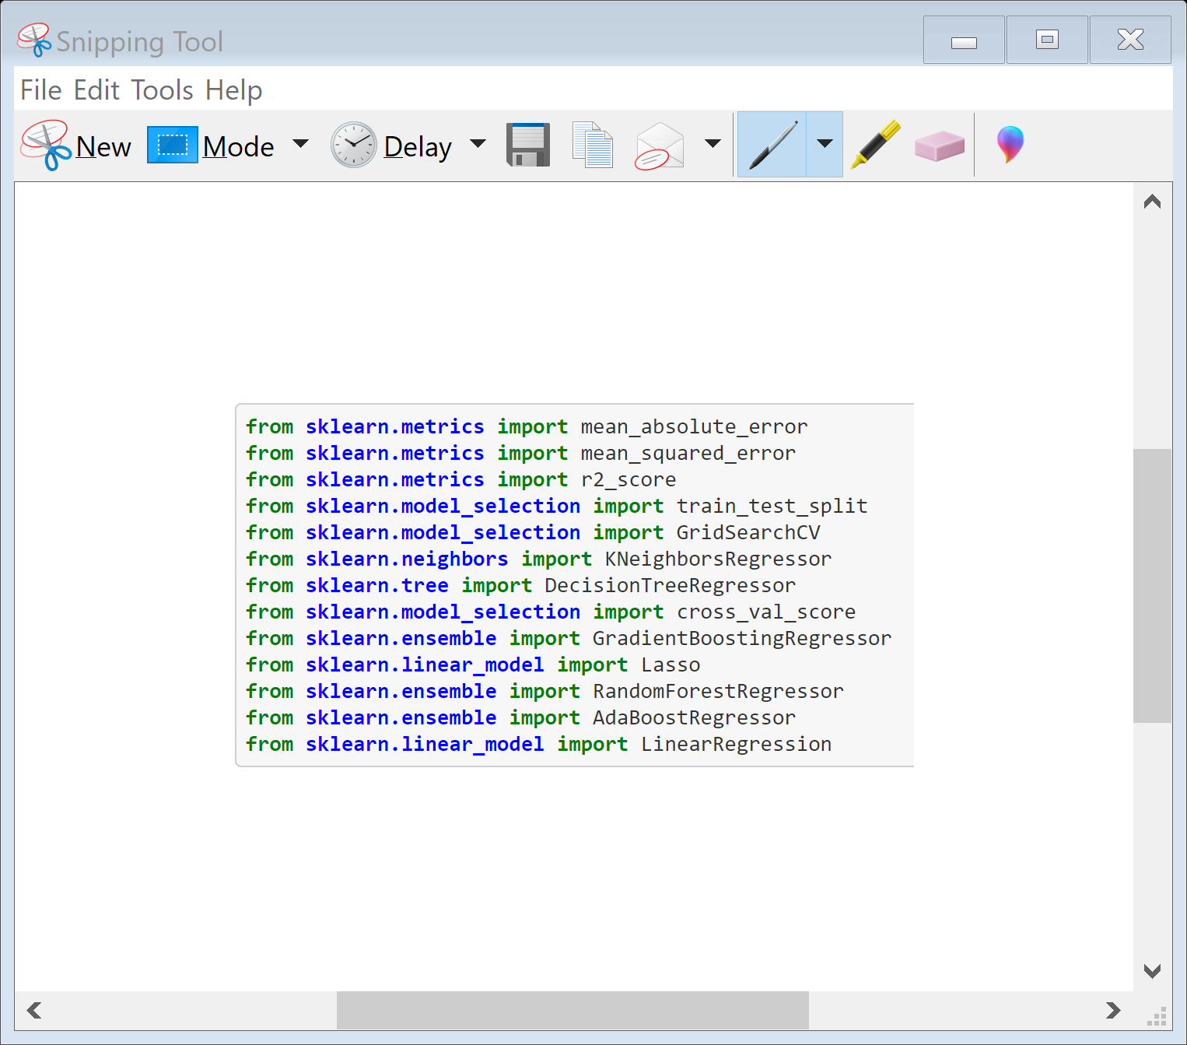
First we will load the necessary libraries .

Slide 18
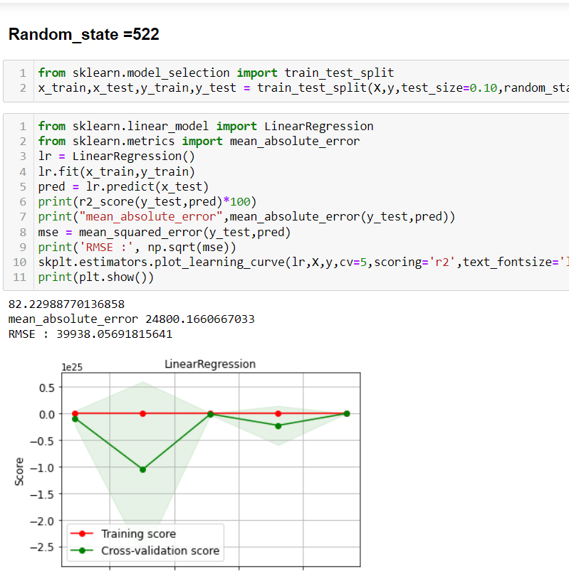
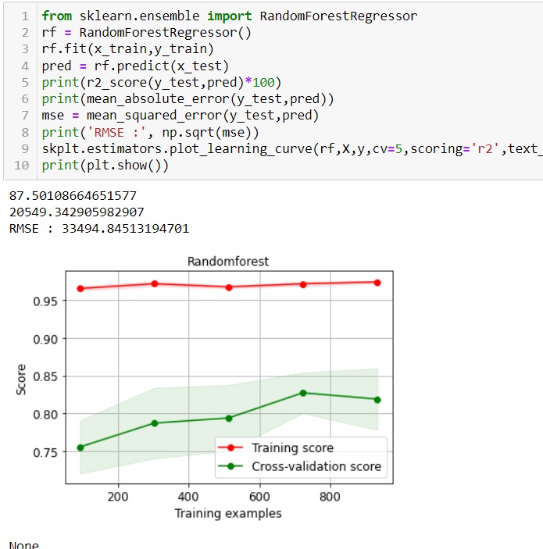
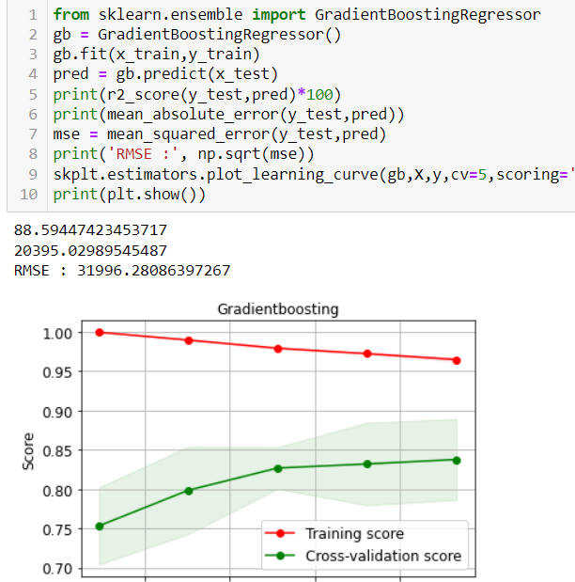
Now we will find best Algorithm for our model

Slide 19


Best model selected by cross validation,R2- score and RMSE Value is Gradient boosting

Slide 20
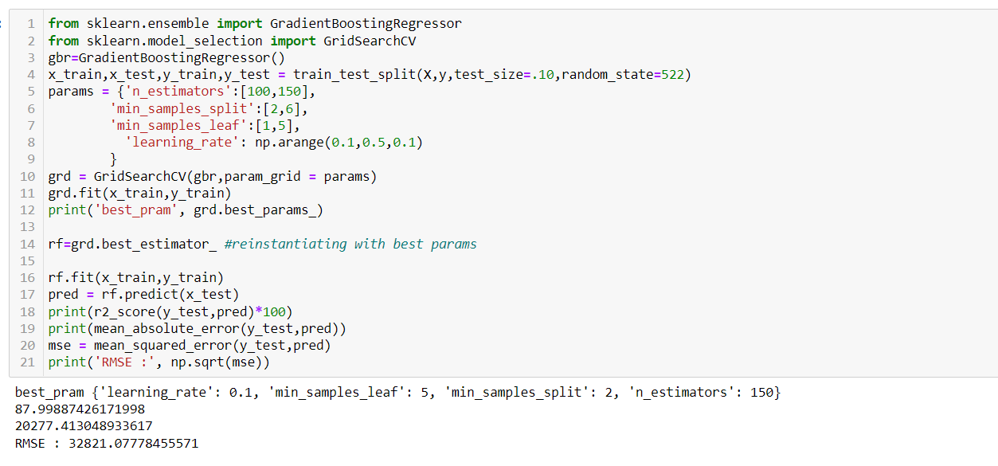
Hypertuning the model by GridsearchCV

Slide 21
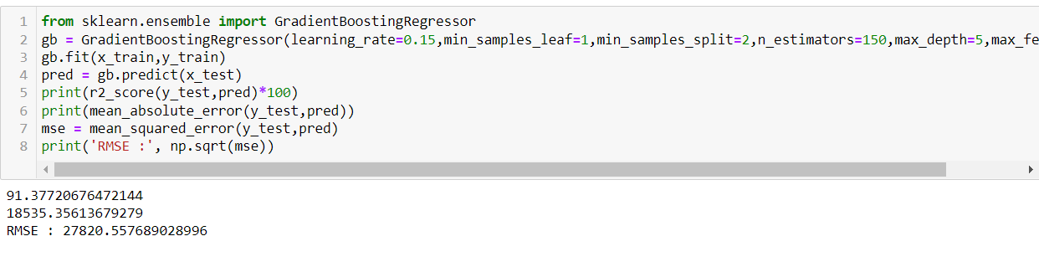
Best parameters and model selected with it

Slide 22
Now we will predict the sale price for our Test data

Slide 23
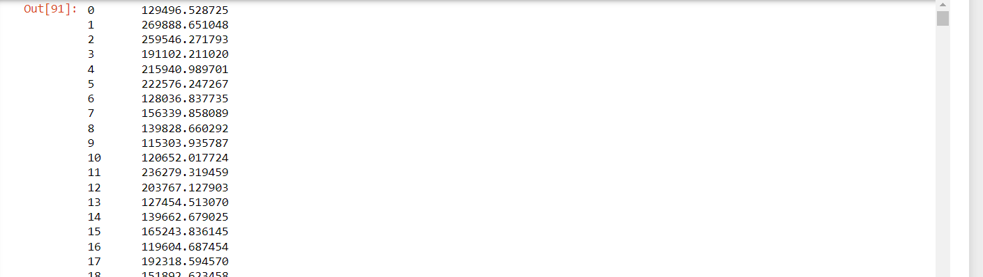
Values of test data

Slide 24
CONCLUSION Key Findings and Conclusions of the Study
Based on the in-depth analysis of the Housing Project,
The Exploratory analysis of the datasets, and the analysis of the Outputs of the models the
following observations are made:
Structural attributes of the house Structural attributes of the house like lot size, lot shape, quality and condition of the house, garage capacity, rooms, Lot frontage, number of bedrooms, bathrooms, overall finishing of the house etc play a big role in influencing the house price.

Slide 25
CONCLUSION Key Findings and Conclusions of the Study
● Due to the Training dataset being very small, the outliers had to be retained for proper training of the models.
● Therefore, Gradient boosting Regressor, being robust to outliers and being indifferent to non-linear features, performed well despite having to work on small dataset.

Slide 26
Learning Outcomes of the Study in respect of Data Science
The goal is to achieve the system which will reduce the human effort to find a house having reasonable price. The proposed system. House Price Prediction model approximately try to achieve the same one. Proposed system focused on predict the house price according to the area for that image processing and machine learning methods are used. The experimental results showed that this technique that are used while developing system will give accurate prediction of house price

